Slide 1
2022-2023 Year End Awards

Slide 2
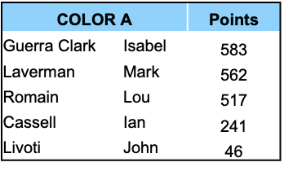
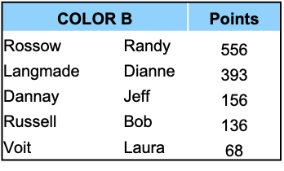
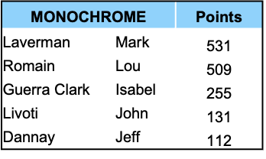
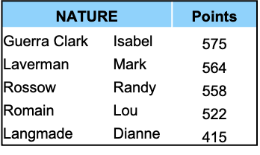
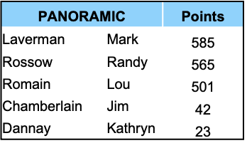
Final Print Standings

Slide 3
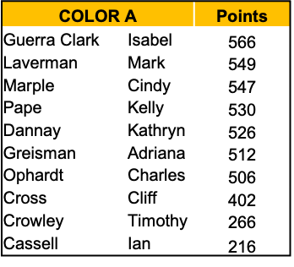
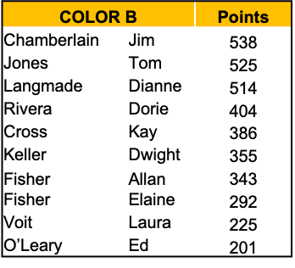
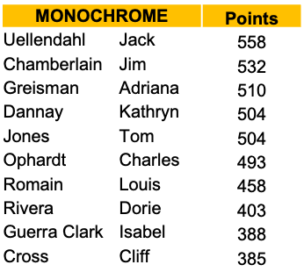
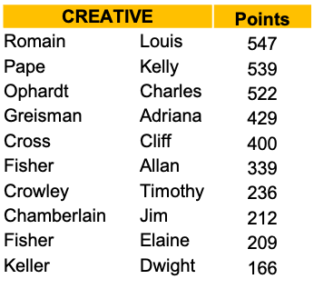
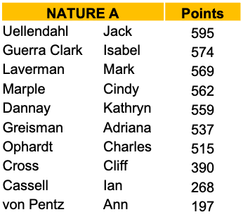
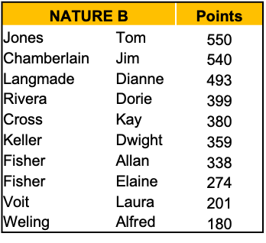
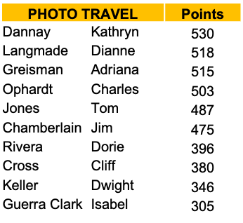
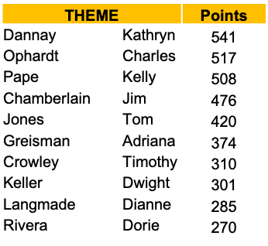
Final Digital Standings

Slide 4
PRINT Award Winners

Slide 5
Year End Awarded Images – Print Color A
Image Name | Member | Score | Award
Pleasant Valley Sunrise | Mark Laverman | 27 | 1st
Blue Hour in Chicago | Isabel Guerra Clark | 27 | 2nd
Echinocereus Spring | Lou Romain | 27 | 2nd
Indian Colors | Isabel Guerra Clark | 26 | HM
Sunrise at the Taj | Isabel Guerra Clark | 26 | HM
Sunset at Disko Bay | Isabel Guerra Clark | 26 | HM
Chicago Riverfront | Isabel Guerra Clark | 26 | HM
Red, white, and blue | Isabel Guerra Clark | 26 | HM
Northern Caridnal Stare | Lou Romain | 26 | HM
Manarola Italy | Lou Romain | 26 | HM
Native Silhoutte | Mark Laverman | 26 | HM
Desert Reflection | Mark Laverman | 26 | HM
Paria Reflections | Mark Laverman | 26 | HM
Navajo Princess | Mark Laverman | 26 | HM
King of the Jungle | Mark Laverman | 26 | HM
Mr and Mrs Lion | Mark Laverman | 26 | HM

Slide 6
Year End Awarded Images – Print Color B
Image Name | Member | Score | Award
Maasai warrior | Randy Rossow | 26 | 1st
Black and blue pearls | Bob Russell | 26 | 2nd
Quetzel | Dianne Langmade | 26 | 2nd
A sticky situation | Randy Rossow | 26 | 2nd
Misty Merced morning | Randy Rossow | 26 | 2nd
Reaching for the sun | Randy Rossow | 26 | 2nd
Savannah sunrise | Randy Rossow | 26 | 2nd
White Pocket sunset | Randy Rossow | 26 | 2nd

Slide 7
Year End Awarded Images – Print Mono
Image Name | Member | Score | Award
Chinese water dragon in mono | Isabel Guerra Clark | 27 | 1st
Black Cloud at white pocket | Isabel Guerra Clark | 27 | 2nd
Golden eye | Lou Romain | 26 | 3rd
High tide | Isabel Guerra Clark | 25 | HM
Curves in mono | Isabel Guerra Clark | 25 | HM
Guru Ka Tal temple | Isabel Guerra Clark | 25 | HM
Milky way over Badwater | Jeff Dannay | 25 | HM
Bells in autumn | Lou Romain | 25 | HM
White study | Lou Romain | 25 | HM
Say what? | Lou Romain | 25 | HM
Indiana January | Lou Romain | 25 | HM
Navajo on horseback | Mark Laverman | 25 | HM
The lions eye | Mark Laverman | 25 | HM
Calling the spirits | Mark Laverman | 25 | HM
Moonstruck | Randy Rossow | 25 | HM

Slide 8
Year End Awarded Images – Print Nature
Image Name | Member | Score | Award
Macaque mother and offspring | Isabel Guerra Clark | 27 | 1st
Three chicks | Isabel Guerra Clark | 27 | 2nd
Mr & Mrs sandhill crane | Isabel Guerra Clark | 27 | 2nd
Rufus Hummer | Lou Romain | 27 | 2nd
The king | Lou Romain | 27 | 2nd
Prowling leopard | Mark Laverman | 27 | 2nd
Safe with momma | Mark Laverman | 27 | 2nd
Owl in flight | Randy Rossow | 27 | 2nd

Slide 9
Year End Awarded Images – Print Panoramic
Image Name | Member | Score | Award
Intrusion | Randy Rossow | 27 | 1st
The Chief at sunrise | Mark Laverman | 27 | 2nd
Teton barn sunrise | Mark Laverman | 27 | 2nd
Mountain reflections | Mark Laverman | 27 | 2nd
Canyon de Chelly sunrise | Mark Laverman | 27 | 2nd
Horton Creek Autumn | Randy Rossow | 27 | 2nd

Slide 10
DIGITAL Award Winners

Slide 11
Year End Awarded Images – Digital Mono
Image Name | Member | Score | Award
Waterbuck Portrait | Jack Uellendahl | 27 | 1st
Dusty Elephant | Jack Uellendahl | 27 | 2nd
Mom & Baby Vervet Monkeys | Jack Uellendahl | 27 | 2nd
Seen double | Isabel Guerra Clark | 26 | HM
Pensive Colobus | Jack Uellendahl | 26 | HM
Elle | Jack Uellendahl | 26 | HM
Mara Lion Portrait | Jack Uellendahl | 26 | HM
Bobcat portrait in Black and White | Jack Uellendahl | 26 | HM
Gorilla in deep thought | Jack Uellendahl | 26 | HM
In Breeding Plumage 2723 MONO | Lou Romain | 26 | HM
Trichocereus Study Mono Sep22 | Lou Romain | 26 | HM

Slide 12
Year End Awarded Images – Digital Color B
Image Name | Member | Score | Award
Weaver Tree Sunset | Jim Chamberlain | 27 | 1st
Majestic Flight | Alfred Weling | 26 | 2nd
Baby with Mother Portrait | Dianne Langmade | 26 | 2nd
African Tree | Dorie Rivera | 26 | 2nd

Slide 13
Year End Awarded Images – Digital Color A
Image Name | Member | Score | Award
I Think We’re in Trouble | Kathryn Dannay | 27 | 1st
Polar Reflections | Cindy Marple | 27 | 2nd
Blue Poison | Isabel Guerra Clark | 27 | 2nd
Faces of India one | Isabel Guerra Clark | 27 | 2nd
Dawn’s Glow | Mark Laverman | 27 | 2nd
Enchanted Rays | Kelly Pape | 27 | 2nd

Slide 14
Year End Awarded Images – Digital Nature B
Image Name | Member | Score | Award
Gila Woodpecker 0875 | Tom Jones | 27 | 1st
Gila Woodpecker Landing on Cholla | Tom Jones | 27 | 2nd
Harris’ Hawk | Tom Jones | 27 | 2nd
Kings Coming at Salisbury | Dianne Langmade | 26 | HM
'Eagle Eye' - Not This Time- CA Condor | Dwight Keller | 26 | HM
Eyes Closed | Jim Chamberlain | 26 | HM
Lion King | Kay Cross | 26 | HM
Gila Woodpecker-8507774 | Tom Jones | 26 | HM
Pyrrhuloxia Male in Flight-1908 | Tom Jones | 26 | HM
Cooper's Hawk Close Up | Tom Jones | 26 | HM
Male Northern Cardinal 5 | Tom Jones | 26 | HM
Antelope Squirrel's Breakfast Time | Tom Jones | 26 | HM
Northern Cardinal Female 5 | Tom Jones | 26 | HM

Slide 15
Year End Awarded Images – Digital Nature A
Image Name | Member | Score | Award
Cypress Trees in Autumn | Beth Ruggiero | 27 | 1st
Family Portrait | Isabel Guerra Clark | 27 | 2nd
Fighting For a Meal | Jack Uellendahl | 27 | 2nd
Bald Eagle Aerobatics | Jack Uellendahl | 27 | 2nd
Close to Momma | Mark Laverman | 27 | 2nd

Slide 16
Year End Awarded Images – Digital Creative
Image Name | Member | Score | Award
Battery Power | Lou Romain | 27 | 1st
Glade Ccreek Grist Mill 6456 | Charles Ophardt | 26 | 2nd
Chevy With Marilyn | Charles Ophardt | 26 | 2nd
In The Headlite 2 | Lou Romain | 26 | 2nd
Around Yellowstone | Lou Romain | 26 | 2nd
Very Fast Action | Lou Romain | 26 | 2nd

Slide 17
Year End Awarded Images – Digital Theme
Image Name | Member | Score | Award
Lightning Over The City | Kelly Pape | 27 | 1st
Mt Rainier NP | Jim Chamberlain | 26 | 2nd
Monument Valley Chief at Sunrise | Kathryn Dannay | 26 | 2nd
Las Vegas | Kay Cross | 26 | 2nd
Mexican Dinner | Kelly Pape | 26 | 2nd
Teton Morning | Kelly Pape | 26 | 2nd
White Sands Field Trip | Tim Crowley | 26 | 2nd

Slide 18
Year End Awarded Images – Digital Photo Travel
Image Name | Member | Score | Award
Taj Mahal Reflection | Isabel Guerra Clark | 27 | 1st
Invasion of Giraffes | Jeff Dannay | 27 | 2nd
Avenue of the Baobabs Madagascar | Dwight Keller | 26 | HM
Soriano before the storm | Ian Cassell | 26 | HM
Patagonia | Isabel Guerra Clark | 26 | HM
Chicago's train tracks | Isabel Guerra Clark | 26 | HM
Torre del Paine | Isabel Guerra Clark | 26 | HM
Sunset and Windmills | Isabel Guerra Clark | 26 | HM
Windmills of Mykonos | Isabel Guerra Clark | 26 | HM
Magic Light | Ron York | 26 | HM
Monument valley with Dust Storm | Timothy Crowley | 26 | HM

